Slide 1
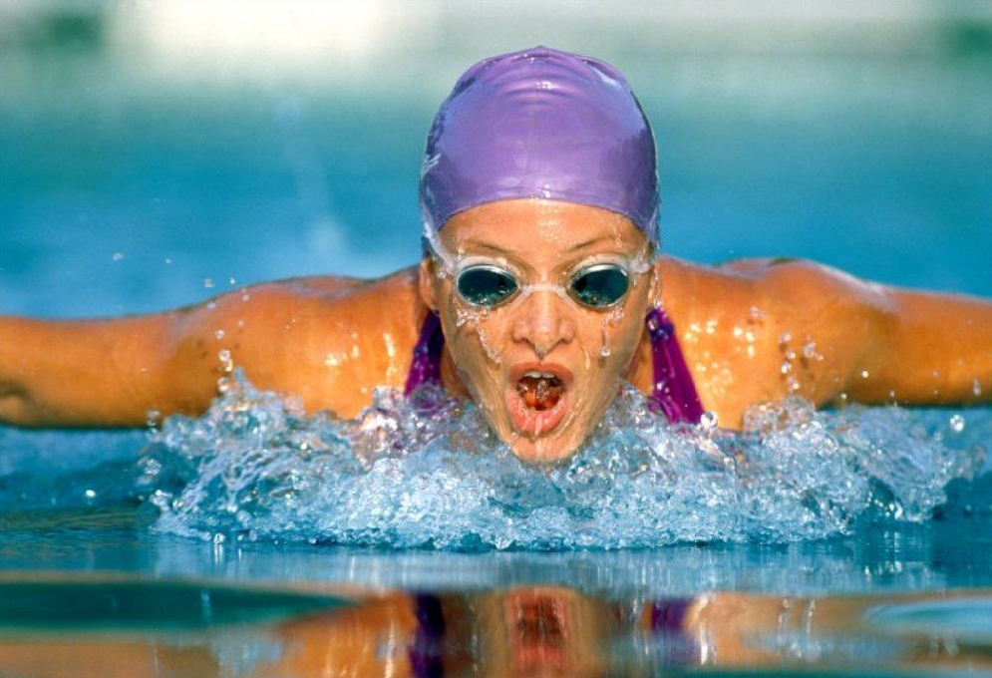
Popular kinds of sport.
Done by :
Gantimurova Olga

Slide 2
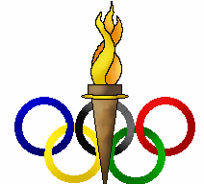
TODAY AT THE LESSON
Olympic Symbols
Different Sports
Olympic Champions

Slide 3
A sound mind in a sound body.

Slide 5
Olympic symbols
-Motto
-Flag
-Olympic rings
-Medals
-Mascots

Slide 6
Alexander Ovechkin is good at
a) Gymnastics
b)Skiing
c) hockey

Slide 7
Elena Isinbaeva is good at
Shooting
Athletics
skiing

Slide 8
Evgeniy Plyshenko is good at
a)Hockey
b) Figure – skating
c) archery

Slide 9
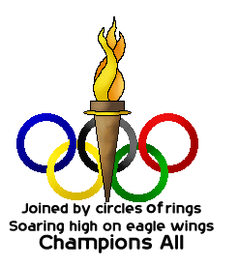
I am good at

Slide 10
Thank you for attention!

