Slide 1
МБОУ
Дуройская СОШ
Медицина: традиции и новые технологии.
Учитель английского языка Гантимурова О.В.

Slide 2
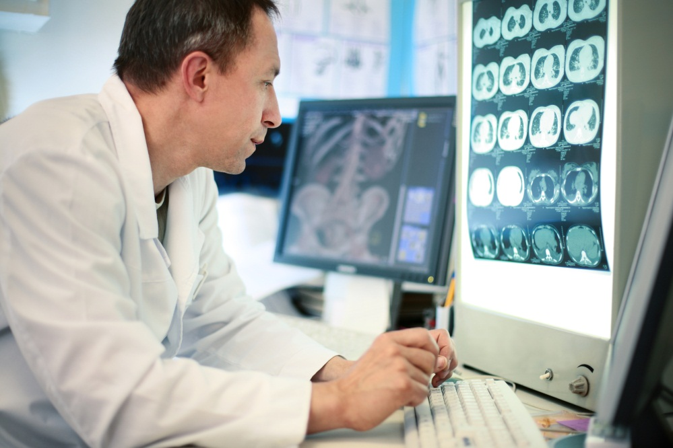
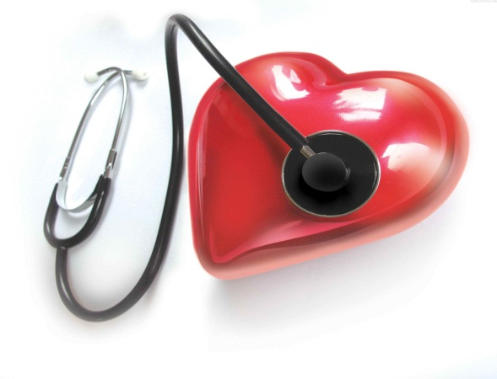
MEDICINE

Slide 3
An apple a day keeps the doctor away. (английская пословица) Дословный перевод: Съедая одно яблоко в день, вы оставите вашего доктора без работы. Кто съедает одно яблоко в день экономит на враче…
Good health is above wealth. (английская пословица) Дословный перевод: Доброе здоровье дороже богатства Русский аналог: Здоровье дороже денег. Здоровье всего дороже. Здоровье дороже всякого богатства.

Slide 4
Early to bed and early to rise, makes a man healthy, wealthy and wise. Дословный перевод: Кто рано лег спать и рано встал утром, тот будет здоровым, богатым и мудрым. Русский аналог: Кто рано ложится и рано встает, здоровье, богатство и ум наживет. Кто рано встает, тому бог подает.

Slide 5
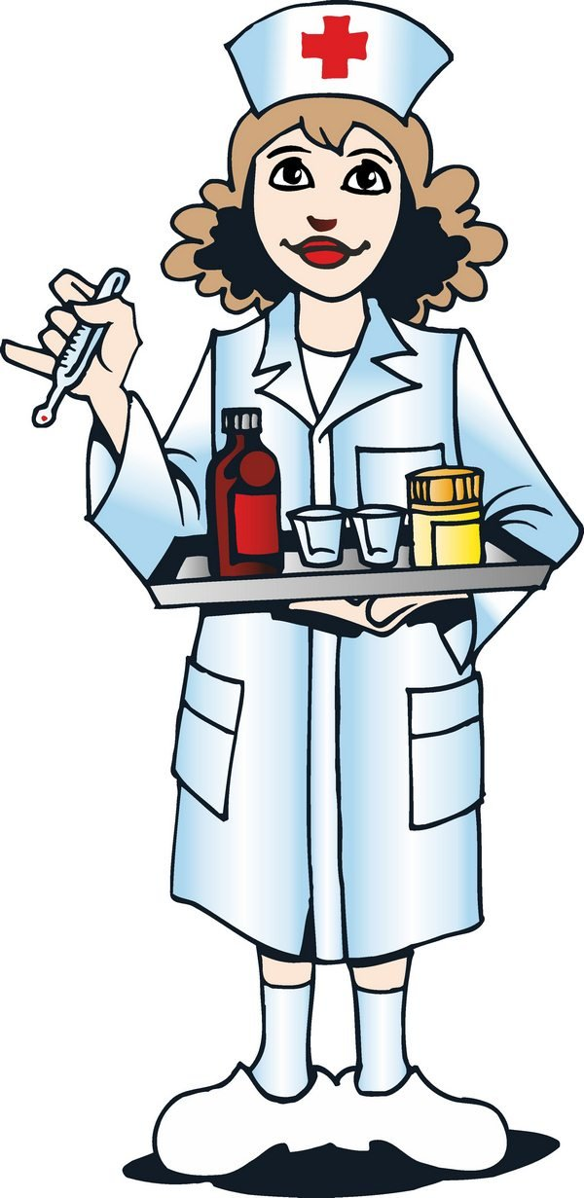

Slide 6
The meaning of the term
Medicine
is the science of diagnosing, treating or preventing diseases and damage to the body or mind.

Slide 7
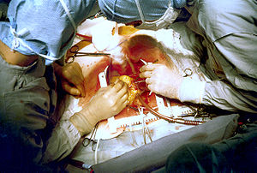
History of Medicine
There are 3 main stages in medicine development: Medicine of Ancient Civilizations, Medicine of Middle Ages and Modern Medicine

Slide 8
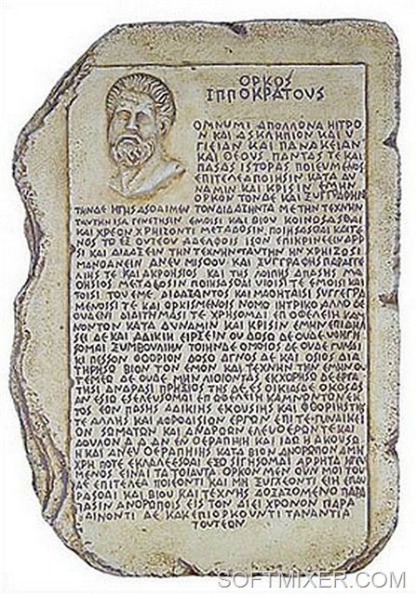
Ancient Civilizations
Main characteristics
-magic
aromatherapy
immunization and acupuncture
preventive medicine
The ethic principles of a physician were summarized by Hippocrates. They are known as Hippocrates Oath.

Slide 9
The Middle Ages
Main characteristics
foundation of universities
discoveries in chemistry, anatomy, biology, others sciences
invention of the stethoscope (by Rene Laennec), vaccination for smallpox, discovery of anesthetics and development of immunology and scientific surgery. -the first hospital that appeared in the 15-th century

Slide 10
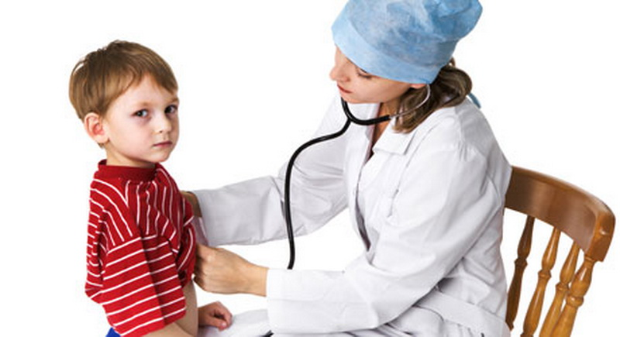
Modern medicine
Main advances
discovery of blood groups and vitamins, invention of insulin and penicillin, practice of plastic surgery and transplantation.

Slide 11
Cure-исцеление Treatment-лечение Remedy-Лекарство

Slide 12
Doctor - a person licensed to practice medicine, as a physician, surgeon, dentist, or veterinarian

Slide 13
Health – the state of being well and free from illness in body or mind

Slide 14
What is better for us? Home remedies, conventional medicine or modern technologies?

Slide 15
Thank you for your attention.

