Slide 1

The theme of the lesson:
Shopping for clothes

Slide 2
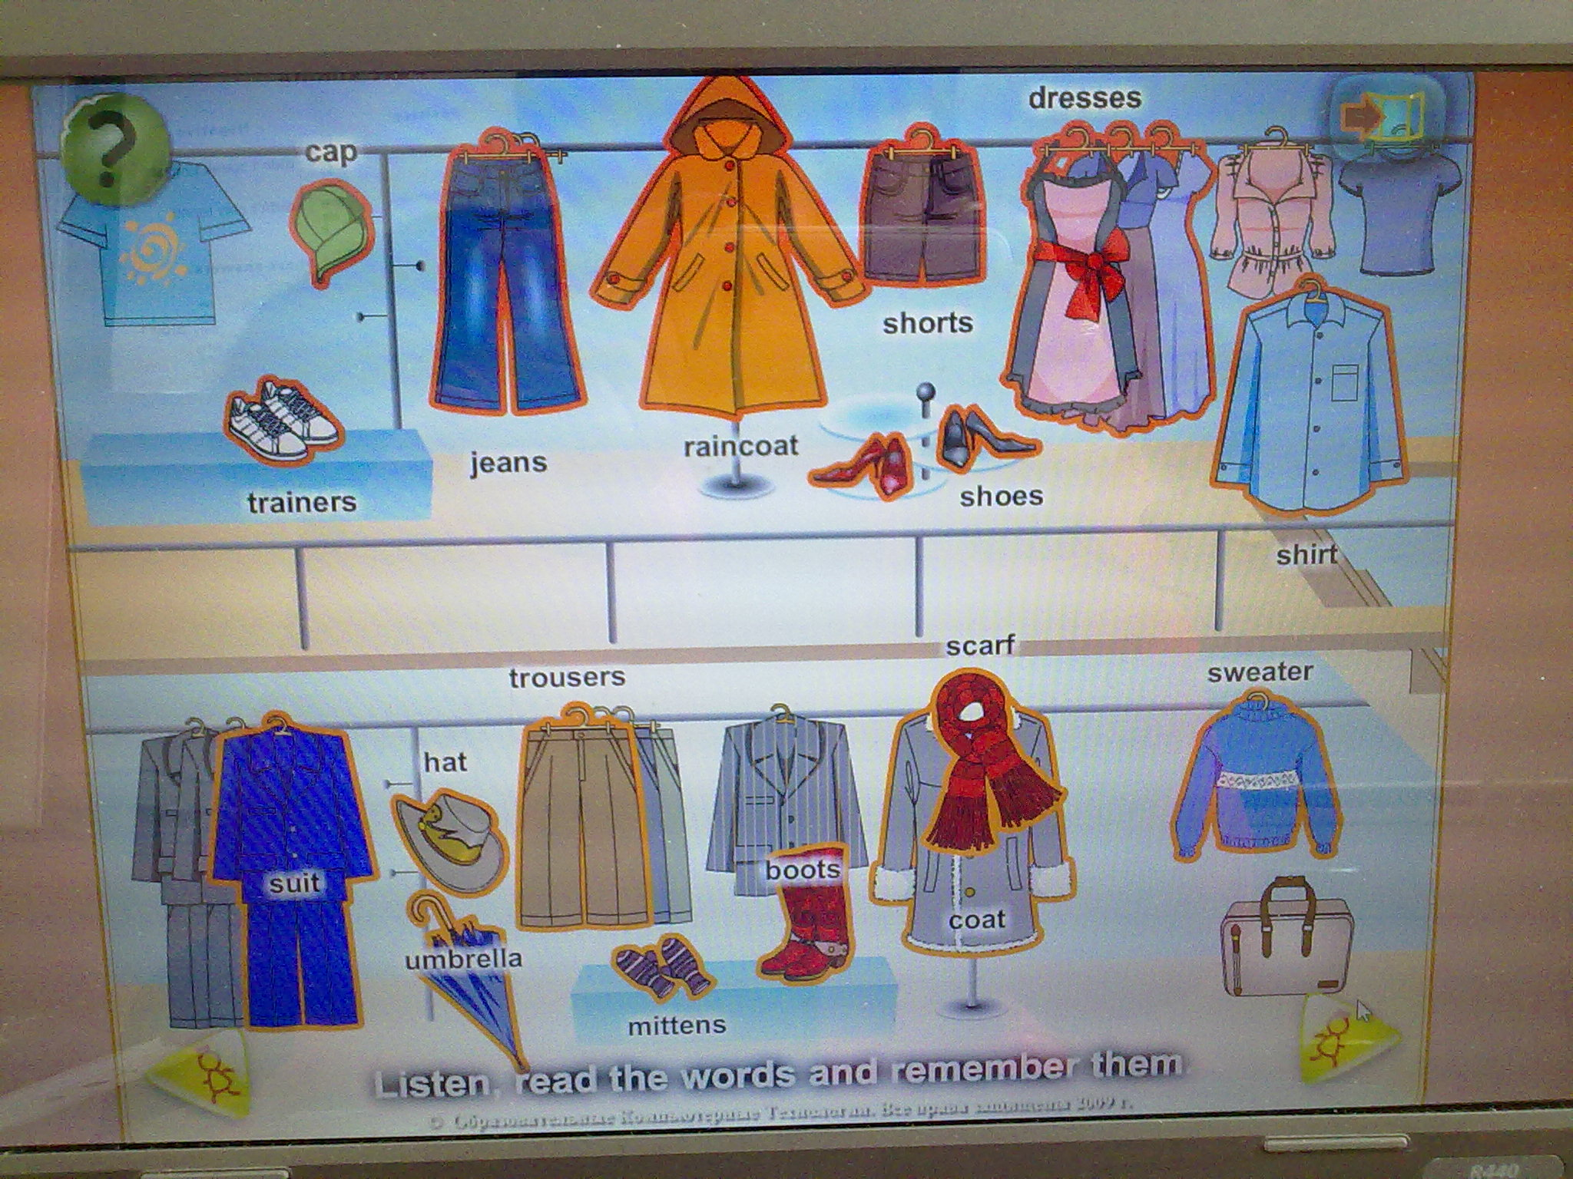
1.My

Slide 3
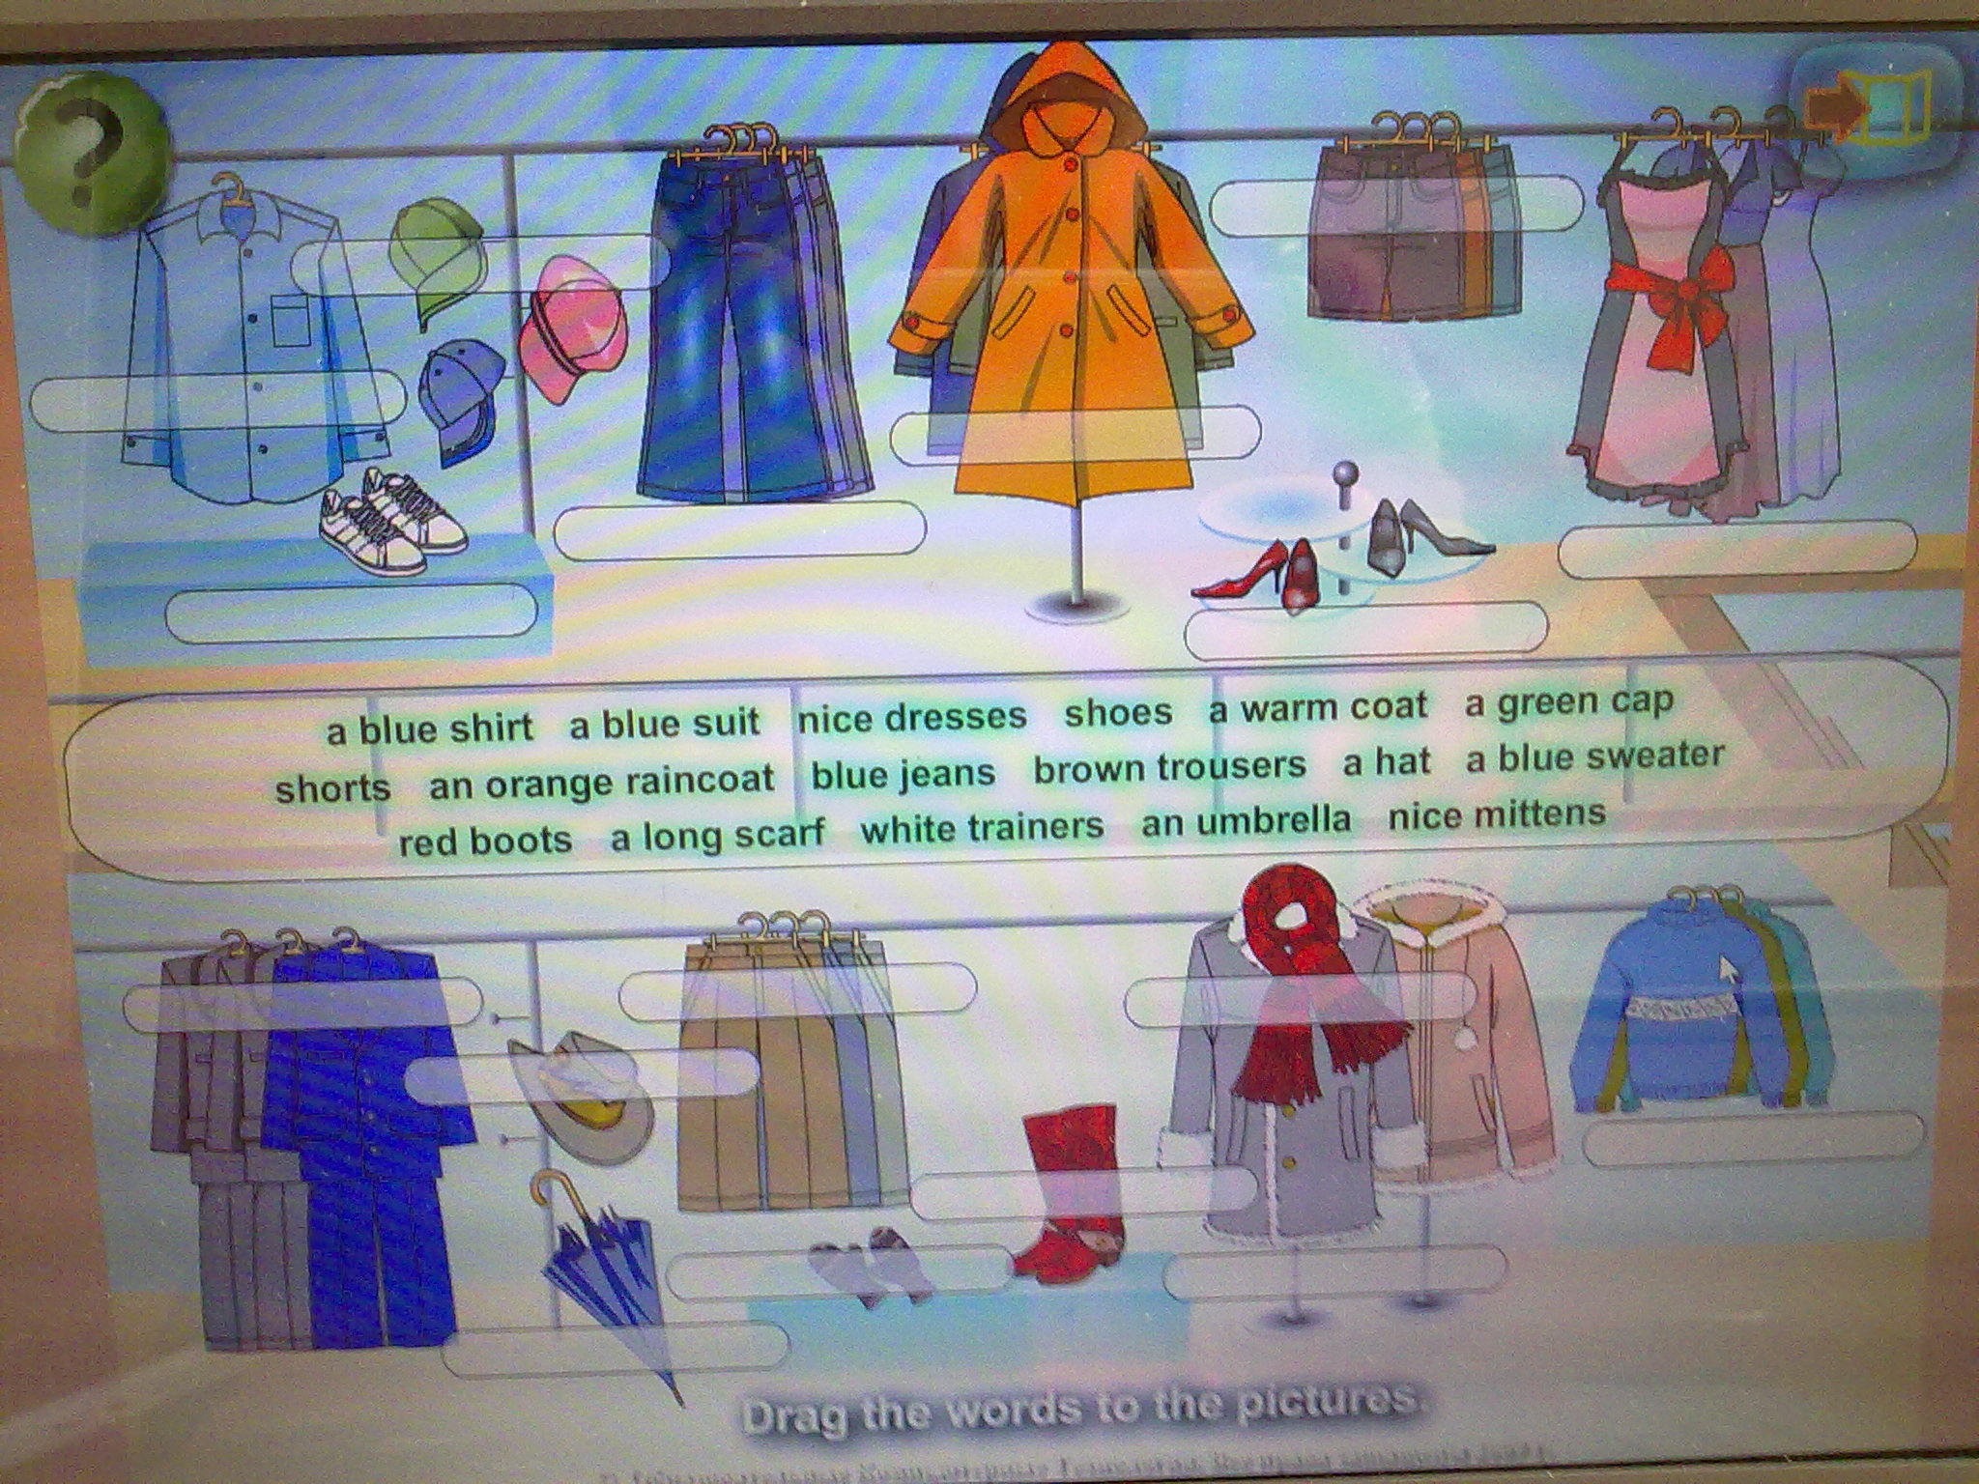

Slide 4

Look at these sentences. Compare them. What are the differences between them?
1.My jeans are blue.
2.My cap is blue.
3.My shorts are very small.
4.My sweater is warm and small.
5.Your trousers are very long.
6.Your suit is big.
7.My clothes are very fashionable.

Slide 5
The rule: Слова trousers, jeans, shorts, clothes употребляются только во множественном числе.

Slide 6
Now open your books at page 86, ex.5. Read this dialogue and answer the question: What did Miss Chatter buy in the shop?

Slide 7
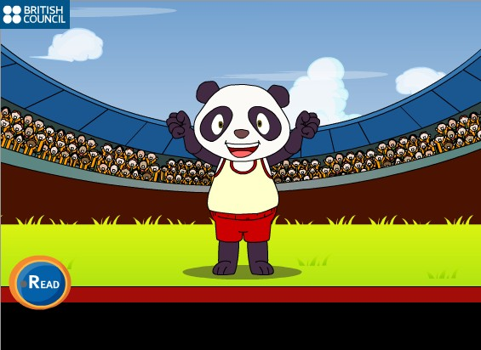
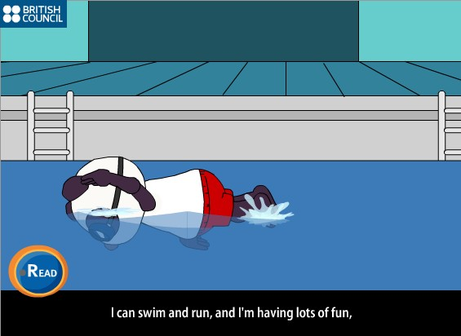
Let’s have a rest.

Slide 8
Make up your own dialogue “In the clothes shop”.
You will work in pairs. You would like to buy clothes:
- for your birthday party.
- for a picnic.

Slide 9
Write down your hometask:
1.To learn by heart new words
2.To make up word combinations and sentences.
3.To draw yourself in your favourite clothes and describe them.

Slide 10
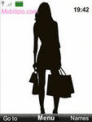
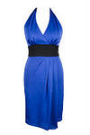
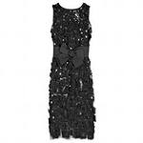
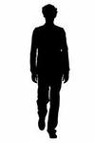
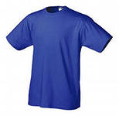
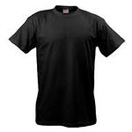

Slide 11
Thank you for your attention!

