Slide 1
“Traffic rules”

Slide 2
«The little red lorry went down Limuru road»

Slide 3
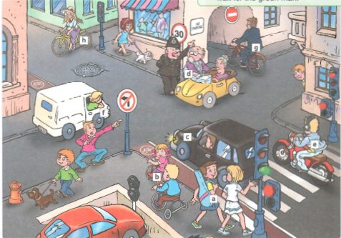
In the picture we can see a ….

Slide 4
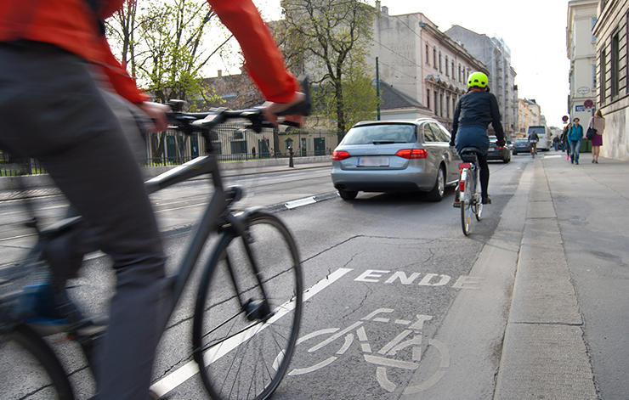
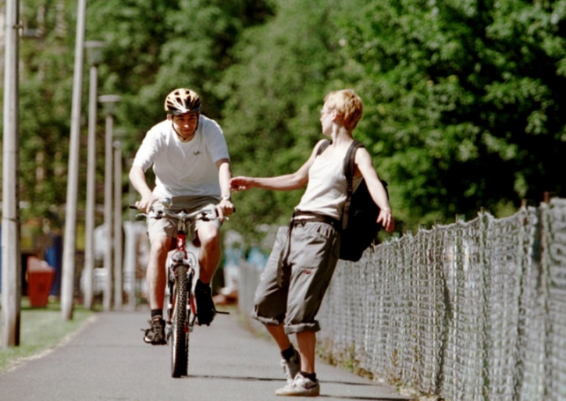
You mustn’t cycle on the pavement.
You must cycle in the cycle lane.

Slide 6
You must switch off your phone when you drive. (личное обязательство, когда вы верите, что должно быть так) You have to be at school at half past eight. (является обязательством, которое обусловлено фактами или правилами, имеет цель или причину).
Modal verbs “must”, “have to”

Slide 7
1. You …cross the road when the traffic light is red. 2. You …cross the road when the traffic light is green. 3. You …wear a crash helmet when you ride a motorbike. 4. You …be careful when you cross the road. 5. You fasten …your seat belt. 6. You …drive more than 60 kph. 7. You …walk on the pavement.
Complete sentences with must\mustn’t:

Slide 8
Thank you for attention!

